Slide 1
Main memory management: virtual memory

Slide 2
Memory Manager
In charge of main memory
Random Access Memory (RAM)
Responsibilities include:
Preserving space in main memory occupied by operating system
Checking validity and legality of memory space request (can not use memory used by others programs)
Setting up memory tracking table
To keep track of who is using which section of memory
De-allocating memory to reclaim it

Slide 3
Old types of memory allocation
Two main types:
Fixed partition system
Dynamic partitions system
The main limitations of these basic memory allocation mechanisms are:
The program must be contiguous.
internal and external fragmentation (fragmentation refer to main memory space that can be utilised due to the nature of partitions)

Slide 4
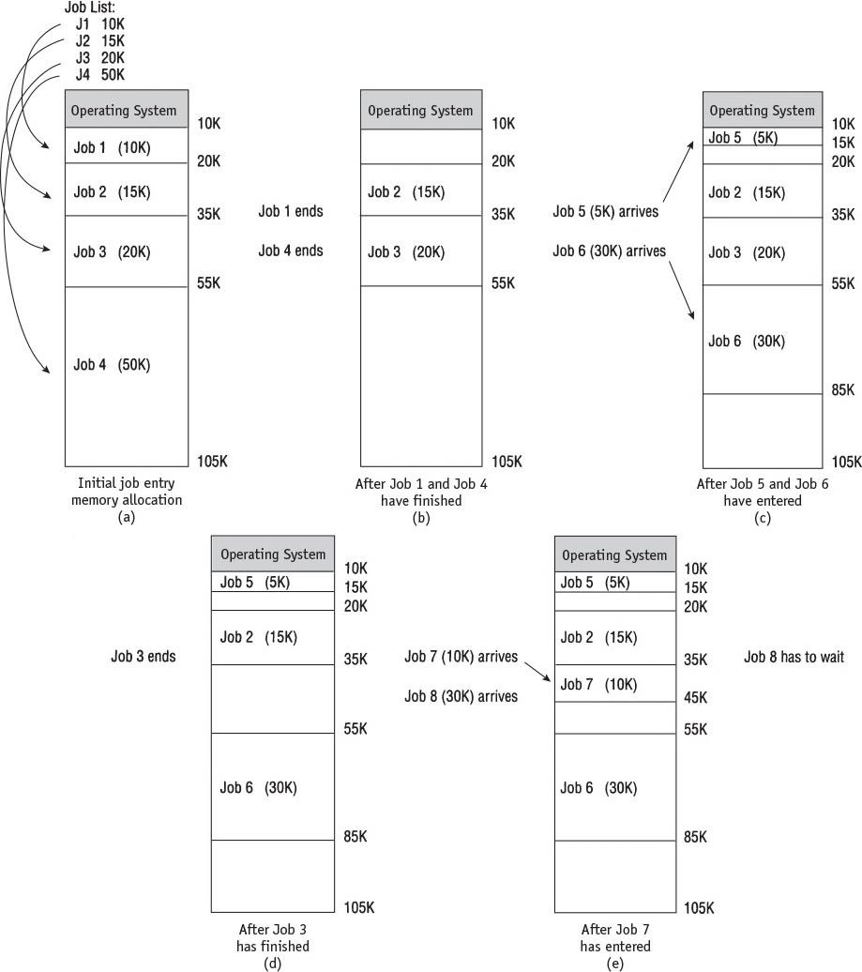
Dynamic memory
Main memory use during dynamic partition allocation. Five snapshots (a-e) of main memory as eight jobs are submitted for processing and allocated space
Job 8 has to wait (e) even though there’s enough free memory between partitions to accommodate it.
External fragmentation (unused memory between blocks)
4

Slide 5
Paged Memory Allocation
Memory manager tasks: prior to program execution
Determine number of pages in program
Locate “enough” empty page frames (frames) in main memory
Load all program pages into page frames

Slide 6
Paged Memory Allocation (cont’d.)
Unlike the previous allocation mechanisms programs can be stored in noncontiguous page frames [in main memory]
Advantages:
more efficient memory use; no external fragmentation however, it does not completely eliminate internal fragmentation
New problem:
keeping track of a job’s pages (what page corresponds to what “page” frame.
This increases operating system overhead

Slide 7
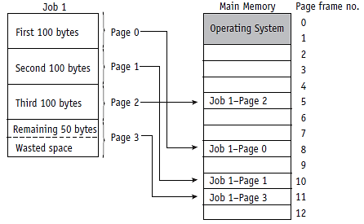
Paged Memory Allocation (cont'd.)
(figure 3.1)
In this simplified example, each page frame can hold 100 bytes.
This job, at 350 bytes long, is divided among four page frames
Internal fragmentation only in job’s last frame: 50 bytes

Slide 8
Paged Memory Allocation (cont’d.)
Entire program: required in memory during its execution
Three tables required for tracking pages:
Job Table (JT),
Page Map Table (PMT), and
Memory Map Table (MMT)
These are stored in main memory operating system’s area

Slide 9
Paged Memory Allocation (cont’d.)
Job Table: information for each active job
Job size
Memory location: job’s PMT
Page Map Table: information for each page
Page number: beginning with Page 0
Memory address (Frame number)
Memory Map Table: basically entry for each page frame
Location of frame
Free/busy status

Slide 10
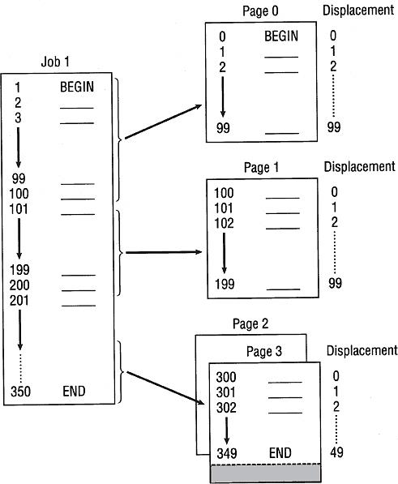
(figure 3.2)
This job is 350 bytes long and is divided into four pages of 100 bytes.
Each that are loaded into four page frames in memory.
The values 1..350 are referred to as the logical address (the way the CPU interoperates a program)

Slide 11
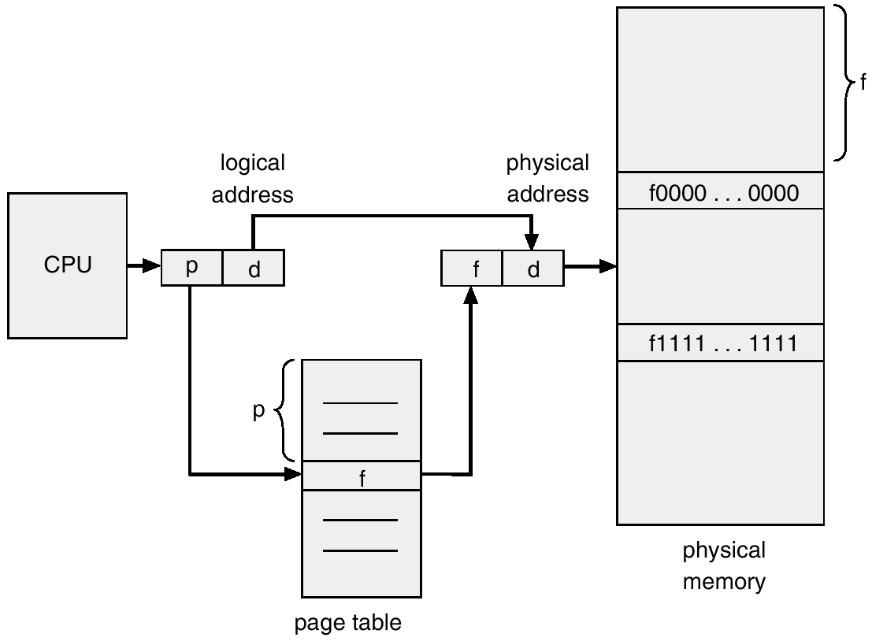
Logical (virtual) v physical address

Slide 12
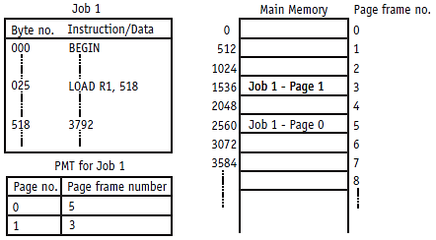
(figure 3.3): This system has page frame and page sizes of 512 bytes each. The PMT shows where the job’s two pages are loaded into available page frames in main memory: the logical address is that in the job. E.g. 518; the physical address is the actual location of this instruction.. In the above example frame 3 position 1536+6 = 1542

Slide 13
Paged Memory Allocation (cont'd.)
Advantages
Efficient memory use: job allocation in noncontiguous memory
Disadvantages
Increased overhead: address resolution
Internal fragmentation: last page
Page size: crucial
Too small: very long PMTs
Too large: excessive internal fragmentation

Slide 14
Virtual Memory Allocation
Virtual memory or demand paged memory allocation: Loads only a part of the program into memory
Removes restriction: entire program in memory
However, Requires high-speed page access
Exploits programming techniques
Modules:
All pages: not needed simultaneously
Examples
Error-handling modules instructions
(give other examples)

Slide 15
Demand Paging swapping
Algorithm implementation: uses Job Table, Page Map Table, and Memory Map Table
However the “demand” Page Map Table (has 3 extra fields): field 1 to 3:
Field 1 says if it is in memory and relates to saving time going from secondary storage to main memory.
Field 2 (modified) is related to outputting frame to secondary storage
Filed 3 referenced: shows recently active versus not active pages. Indicates which pages stay in memory and which can be swapped out.

Slide 16
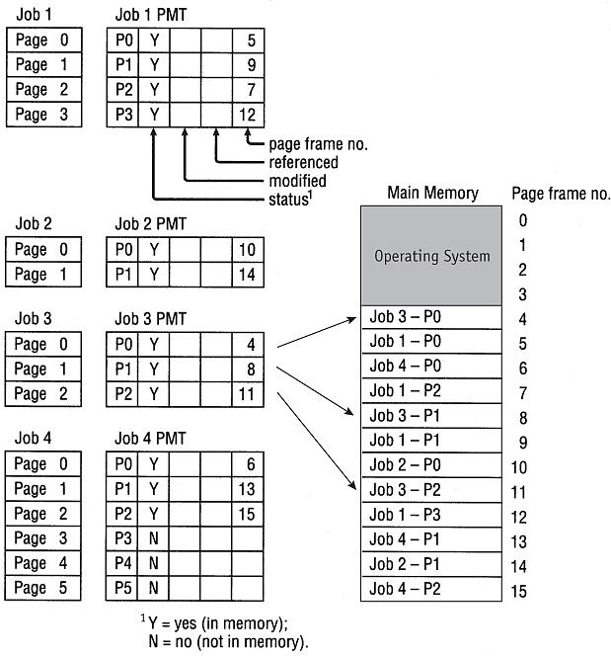
(figure 3.5)
Demand paging swapping requires that the Page Map Table for each job keep track of each page as it is loaded or removed from main memory. Each
PMT tracks:
the status of the page
whether it has been modified,
whether it has been recently referenced,
the page frame number for each page currently in main memory.

Slide 17
Demand Paging Memory Allocation (cont'd.)
Swapping process:
Find the page number
Determine page status: already in memory
Resident memory page: exchanged with secondary storage page if modified
Resident page: copied to disk (if modified bit set to 1)
A New page: written into available page frame

Slide 18
Demand Paging Memory Allocation
Page fault: failure to find page in memory
Generate a page interrupt (stops execution of the processing)
Page fault handler: part of operating system
Determines if empty page frames in memory
Yes: requested page copied from secondary storage
No: swapping (dependent on the predefined page removal algorithm)
Tables updated when page swap occurs
PMT for both jobs (page swapped out; page swapped in)
If frame modified write to disk

Slide 19
Demand Paging Memory Allocation
Thrashing (Excessive page swapping)
Results in inefficient operation of memory management
Main memory pages: removed frequently; called back soon thereafter
Occurs across jobs
Large number of jobs: limited free pages (a lot of swapping would be required to satisfy all jobs)
Occurs within a job
If Loops crossing page boundaries ( figure 3.6)
In this example Swapping (generation of page faults) will occur 100 times so useful processing is degraded by a factor of 100

Slide 20
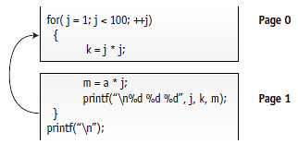
(figure 3.6)
An example of demand paging that causes a page swap each time the loop is executed and results in thrashing. If only a single page frame is available, this program will have one page fault each time the loop is executed. © Cengage Learning 2014

Slide 21
Page Replacement (swapping) policies and concepts
Page replacement policy
Crucial to system efficiency; number of generate page faults/page interrupts is minimal
Two well-known algorithms
First-in first-out (FIFO) policy – uses queues
Best page to remove: page in memory longest
Least Recently Used (LRU) policy
Best page to remove: page least recently accessed (based on principle of locality: page used will likely be used again quite soon)

Slide 22
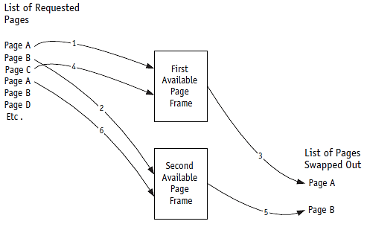
(figure 3.7)
First, Pages A and B are loaded into the two available page frames. When Page C is needed, the first page frame is emptied so C can be placed there. Then Page B is swapped out so Page A can be loaded there. © Cengage Learning 2014

Slide 23
The Mechanics of Paging (cont'd.)
Page Map Table: bit meaning
Status bit: page currently in memory
Referenced bit: page referenced recently
Determines page to swap: LRU algorithm
Modified bit: page contents altered
Determines if page must be rewritten to secondary storage when swapped out
Bits checked when swapping
FIFO: modified and status bits
LRU: all bits (status, modified, and reference bits)

Slide 24
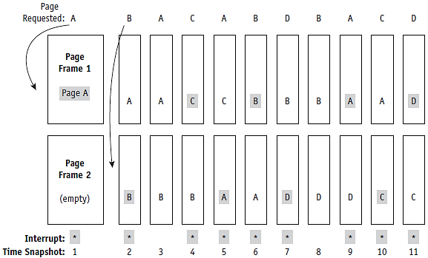
(figure 3.8)
Using a FIFO policy, this page trace analysis shows how each page requested is swapped into the two available page frames. When the program is ready to be processed, all four pages are in secondary storage. When the program calls a page that isn’t already in memory, a page interrupt is issued, as shown by the gray boxes and asterisks. This program resulted in nine page interrupts. What is the failure rate

Slide 25
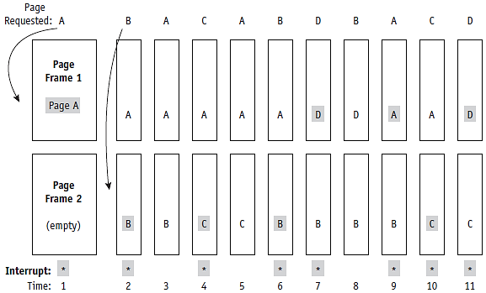
(figure 3.9)
Memory management using an LRU page removal policy for the program shown in Figure 3.8. Throughout the program, 11 page requests are issued, but they cause only 8 page interrupts. © Cengage Learning 2014

Slide 26
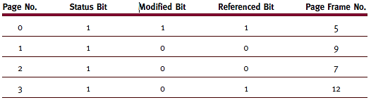
The Mechanics of Paging
Page swapping
Memory manage requires specific information: Page Map Table
(table 3.3)
Page Map Table for Job 1 shown in Figure 3.5.
A 1 = Yes and 0 = No. © Cengage Learning 2014

Slide 27
How to Determine which Page Frame is Least Recently Used
This algorithm is based on the principle of locality:
Pages recently referenced are likely to be referenced again in the near future.
Two types of locality of reference:
Spatial locality (code on the same page)
Temporal locality (code that are used in loops: these can be on the same or neighbouring pages)
This limits the amount of swapping required.

Slide 28
The LRU Clock policy technique
Clock policy is a method used to establish easily and quickly if a page is recently referenced (used)
Only requires one bit to record when a page has been referenced
memory management unit needs to set this whenever a page is referenced
Scan referenced bits in a circular manner looking for a page which has not been referenced
i.e (referenced bit of the PMT = 0)
If a bit is =1 reset reference bit to 0 as each entry is examined if bit is 0 it is targeted for removal.

Slide 29
Clock policy-scanning for a page to remove
Before
After
This page remove
Unused pages
Used pages

Slide 30
Cache Memory
Small, high-speed intermediate memory unit
Computer system’s performance increased
Faster processor access compared to main memory
Stores frequently used data and instructions
Data/instructions: move between main memory and cache.
Methods similar to paging algorithms

Slide 31
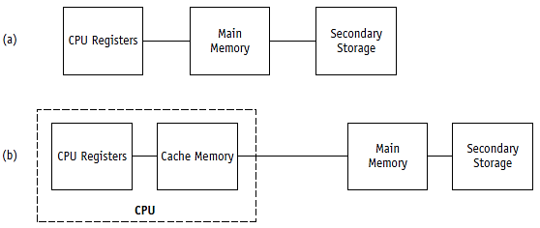
CPU registers: speed up lookup process by storing PMT/SMT of recently entries for active jobs
(figure 3.19)
Comparison of (a) the traditional path used by early computers between main memory and the CPU and (b) the path used by modern computers to connect the main memory and the CPU via cache memory. © Cengage Learning 2014

Slide 32
Potential Exam Questions
Describe, using a suitable example, the relationship between logical and physical memory. (4 marks)
What is the purpose of the: modified field, status field and the referenced field in the PMT of the demand page memory management system (6 marks)

Slide 33
Sample exam questions
Distinguish, using suitable examples the difference between the FIFO and the LRU page swapping algorithms (10 marks).
Trashing is a drawback of virtual memory. Explain using a suitable example what is meant by this concept. (6 marks)
What is the purpose of cache memory (4 marks)

